Slide 1
How to Improve Authorization Rate

Slide 2
The problem
To help merchants to optimize the conversion and acceptance of payments to increase their revenues
In order to do so, we would first have to understand what causes declined transactions and frauds, and what factors helps to improve acceptance rate.

Slide 3
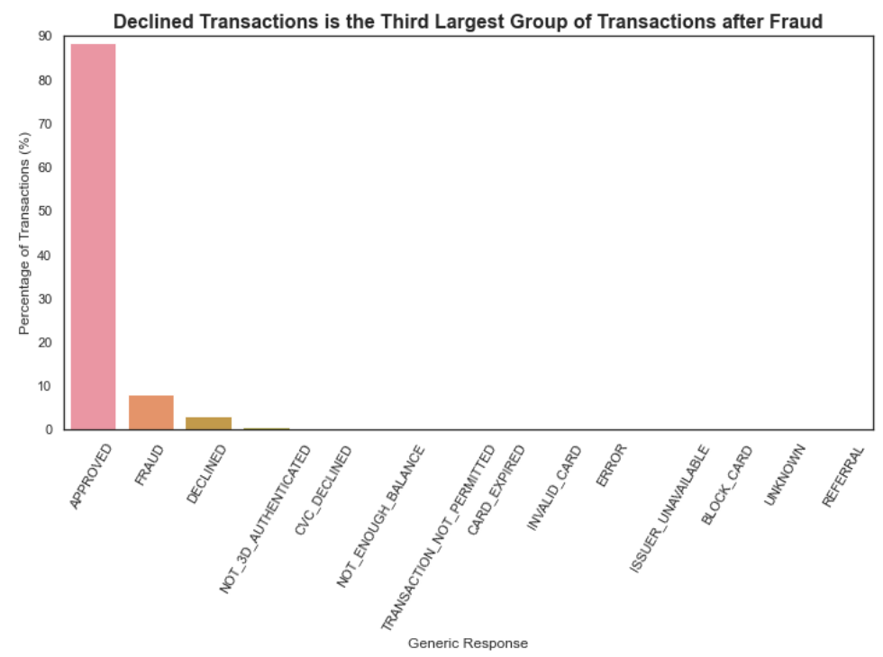
Why do we need to look at fraud and declined transactions?

Slide 4
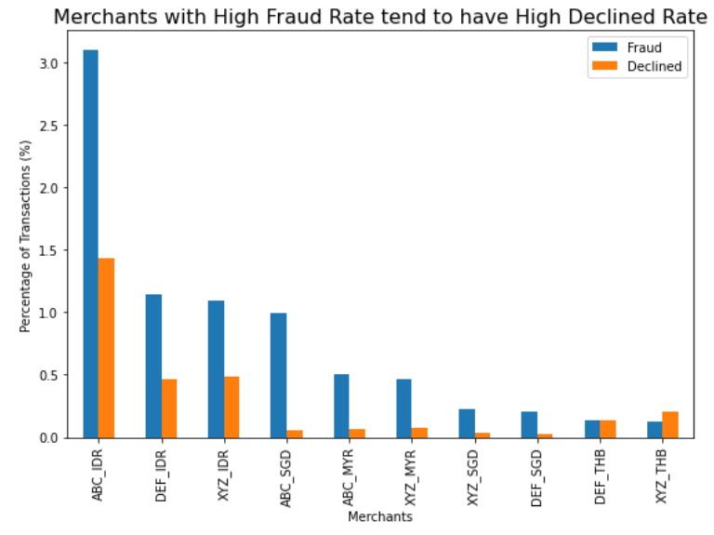
Fraud Rate Matters
Reduce fraud transactions to reduce declined transactions

Slide 5
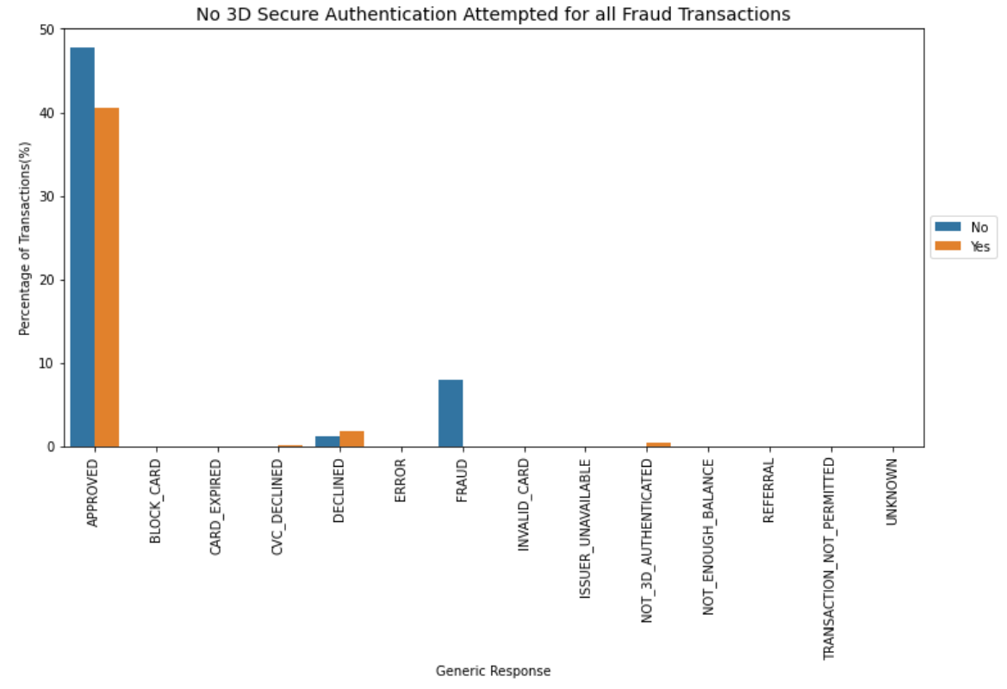
What’s worrying?

Slide 6
But 3DS might create inconvenience to customers

Slide 7
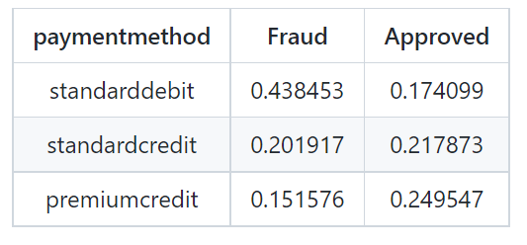
Let’s Dive Deeper
Top three payment method for fraud transactions is the same top three payment method for approved transactions

Slide 8
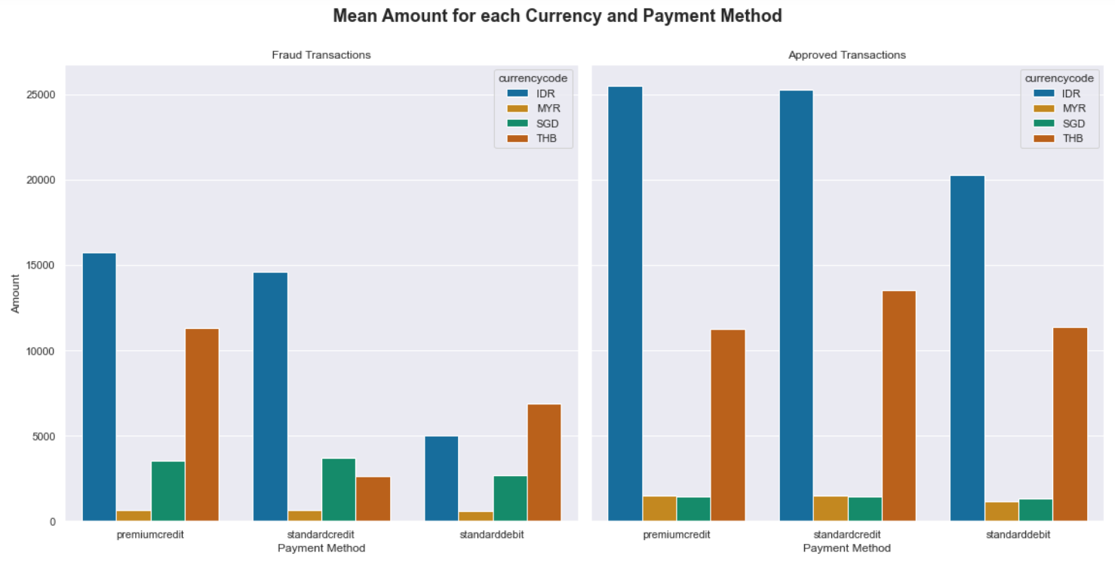
Use 3DS when transaction is above a minimum amount?
Mean approved transacted amount is higher mean fraud amount

Slide 9
Solution
frictionless authentication process
seamless payment experience for customers
Implement 3DS2

Slide 10
What about declined transactions?

Slide 11
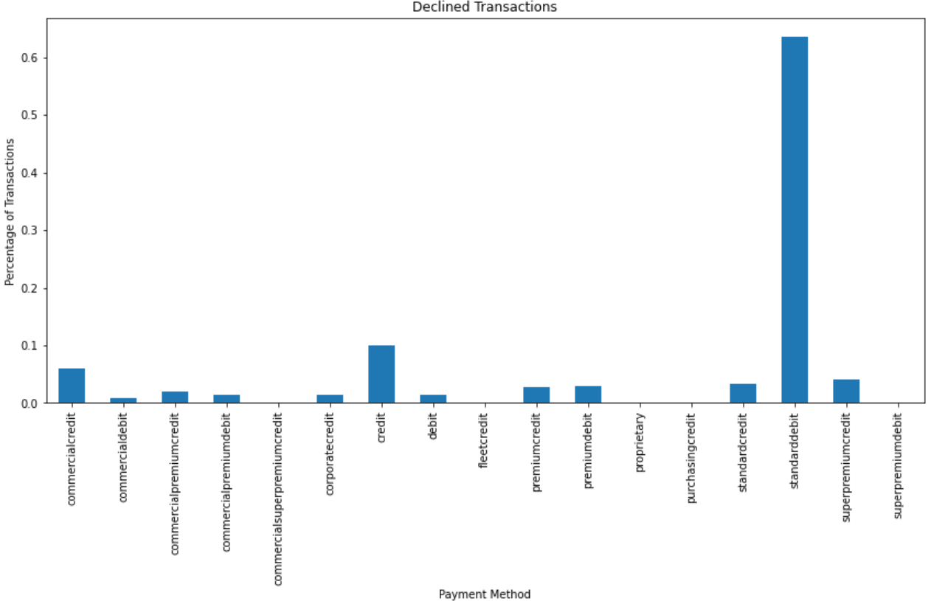
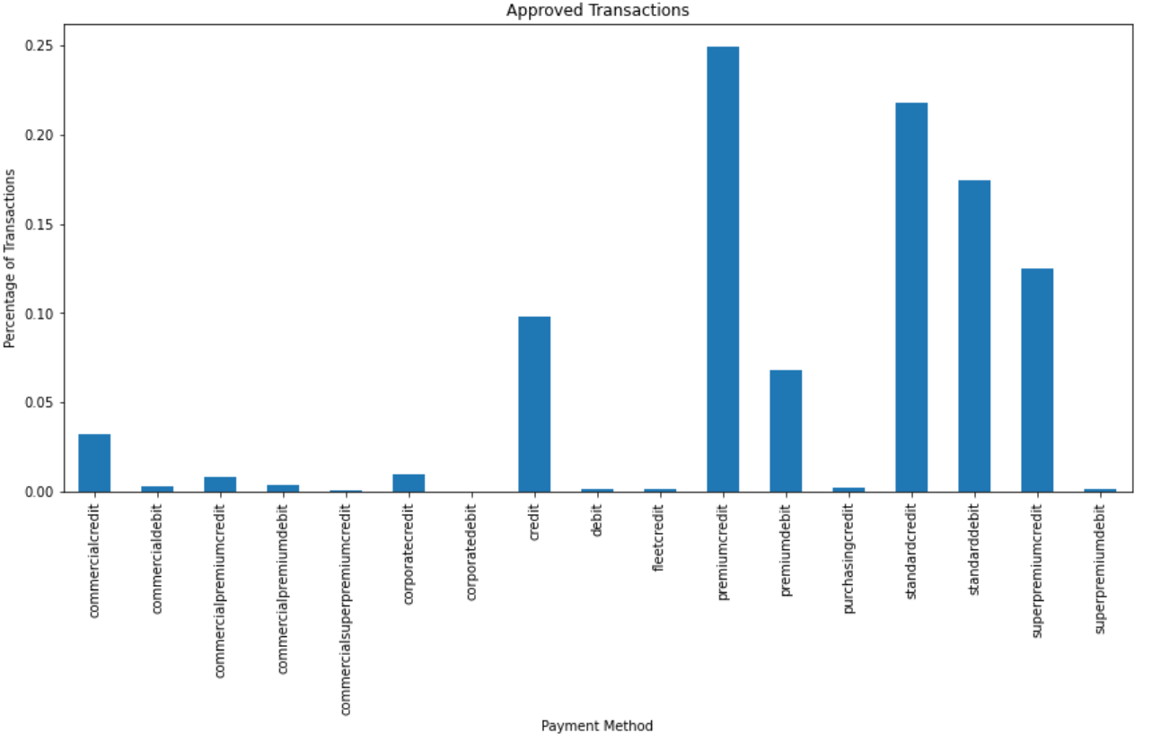
The Troublemaker
Standard Debit is the top payment method for declined transactions
17.41% of approved transactions is done via standard debit

Slide 12
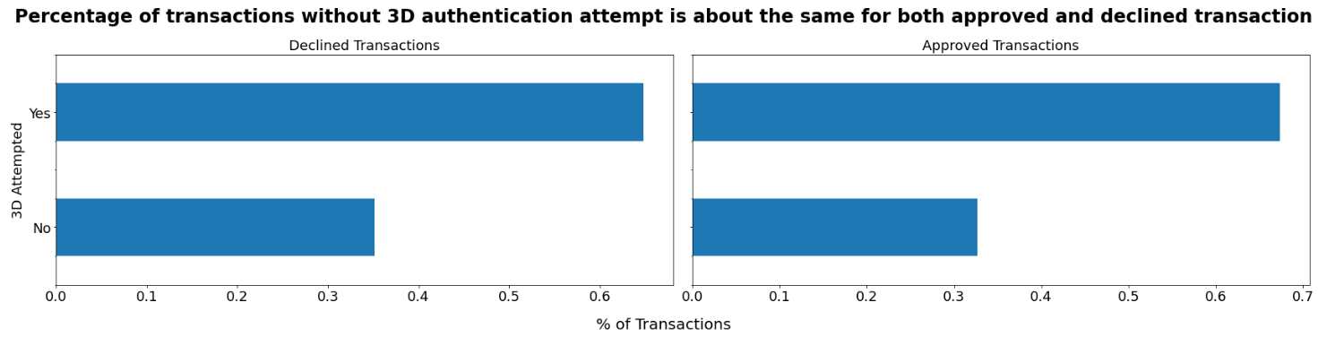
One Third of Transactions are WITHOUT 3DS Attempts

Slide 13
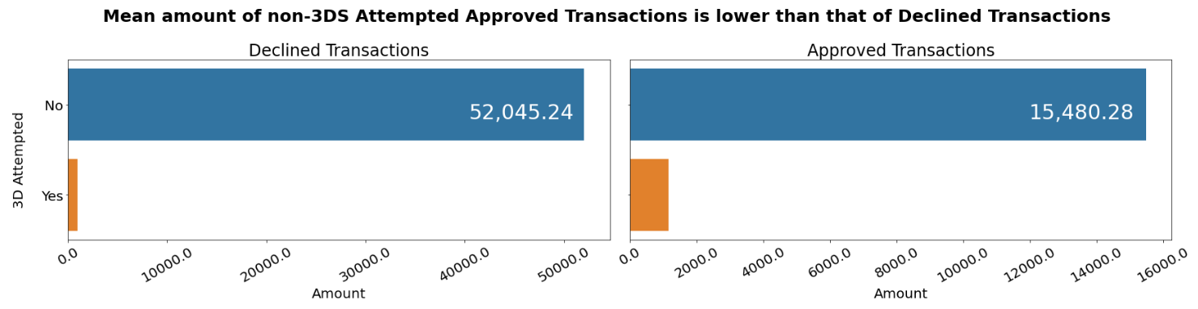
Money Talks

Slide 14
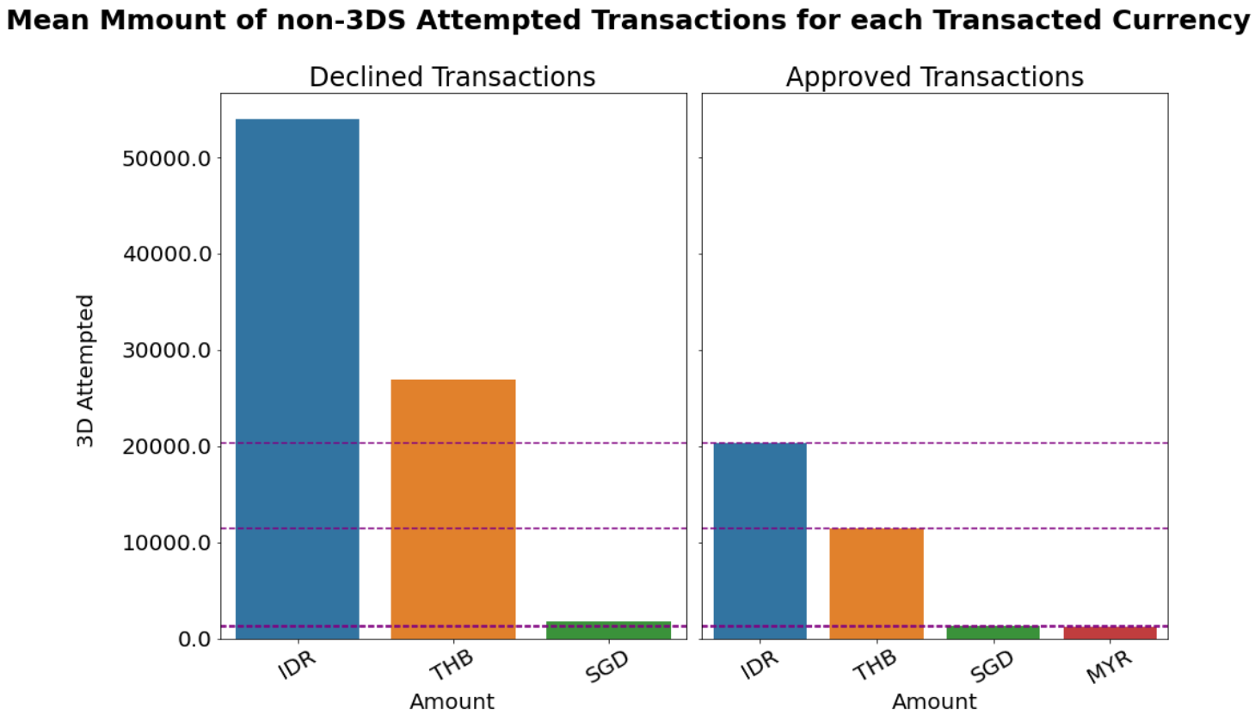
Solution
Implement 3DS if transactions amount is above a minimum amount

Slide 15
Anything else that we can do if we don’t want to use 3DS?

Slide 16
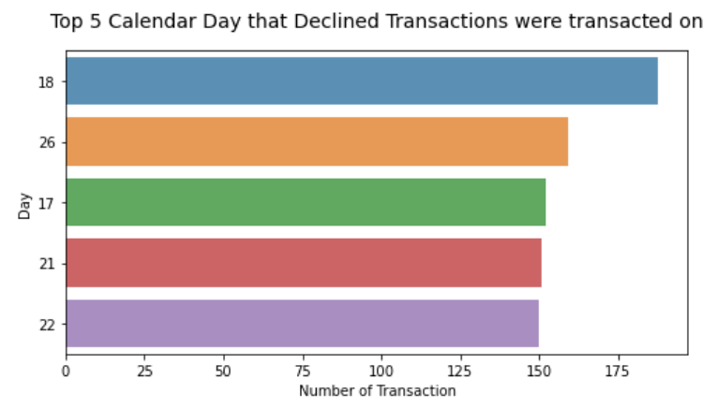
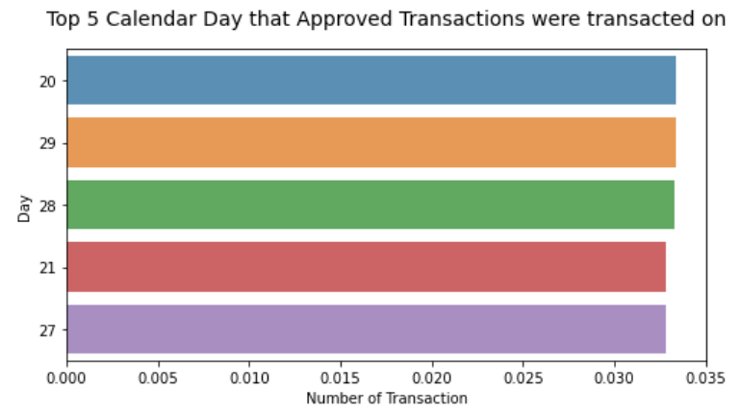
Calendar Day of Transaction
Avoid routing transactions on these calendar day:
18th
26th
27th
Best calendar day to route transactions:
20th
29th
28th

Slide 17
It was the best of times. It was the worst of times.
The 18th and 19th hour are common top five hours for both approved and declined transactions
Hour | % of Declined Transactions
15 | 6.622
18 | 6.535
14 | 6.419
12 | 6.041
19 | 6.041
Hour | % of Approved Transactions
19 | 6.735
18 | 6.405
17 | 6.115
9 | 6.107
13 | 5.914

Slide 18
You can't keep today's hour for tomorrow
Calendar Day | % of Declined Transactions
18 | 9.700
27 | 6.005
13 | 6.005
16 | 5.312
22 | 4.388
Calendar Day | % of Declined Transactions
16 | 4.039
12 | 4.012
25 | 3.739
30 | 3.657
19 | 3.603
If you need to route transactions on the 18th and 19th hour, best to avoid doing it on:
18th
27th
13th

Slide 19
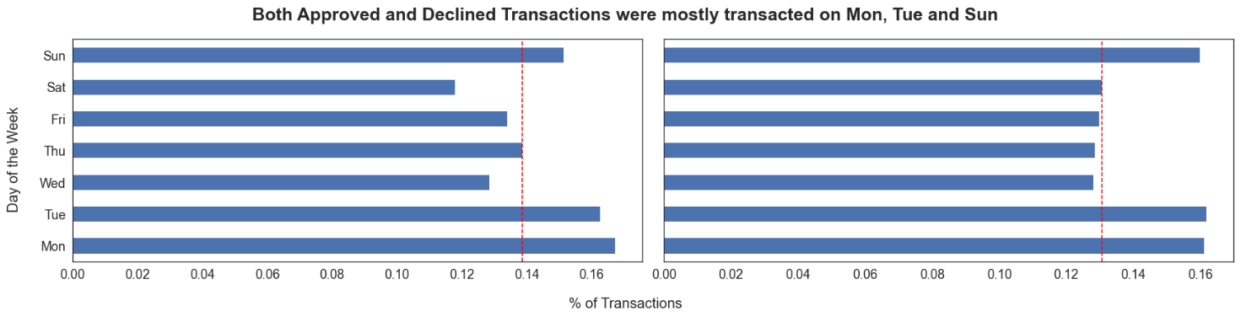
TGIF
Similar day of the week is observed for both declined and approved transactions.

Slide 20
Day of the week and Hour Combo Power
Day, Hour | % of Declined Transactions
Tue, 12pm | 2.595
Mon, 3pm | 2.595
Tue, 4pm | 2.535
Calendar Day | % of Declined Transactions
Mon, 7pm | 2.651
Sun, 2pm | 2.451
Mon, 9am | 2.421

Slide 21
Conclusion
Use 3DS if transaction amount is above the threshold amount
Use 3DS2 for transaction amount below the threshold amount
Route transactions on days and hours when approval rates are higher
Avoid routing transactions when declined rates are higher

